Slide 1

Vladislav Stoimenov
235030
01/09/25 – 19/01/26
[photo]
Placement Log
2025-2026

Slide 2

How To Use
This Template
As a student at Breda University of Applied Sciences studying to become a professional, you are required to provide evidence that demonstrates your professional learning and growth during the block. This template is intended to provide you with a well-structured and organised format for doing this effectively. Keep in mind that certain competencies may require you to update your evidence every week, and others may have only be relevant during a particular week or two.
With the evidence you present here teachers should get a clear and comprehensive overview of your progress, how you’ve engaged with feedback, as well as your general attitude and performance as a student and as an aspiring professional developer.
Note that number and size of text boxes and how they are organized on each slide may be modified as needed. It is up to you to decide what layout is most effective for the content you are providing. You may also add slides if needed, but try to be as economical as possible, i.e. quality over quantity. Focus on the things that are the most significant and meaningful.
You are also free to stylise this template to improve the graphic design and visual appeal, but please remember its purpose: to provide evidence of your progress towards becoming a professional developer. Changes should only enhance and extend the information, and may never subtract. I.e. do not delete anything or change the order of things. If in doubt, seek approval from your teachers!

Slide 3
Learning Log
Structure
Section A - My Plan Must be completed in week 1
Your plan describes your goals for the placement. Starting with where you are right now, where do you want to be at the end of the placement? I.e. what role(s) will you take responsibility for, and how will you demonstrate progress relevant to the ILOs for this placement? What tasks and deliverables are best aligned with your role and the project?
Section B - Weekly Log Must be updated every week
This is simply a log (journal) of what you do each week, and what you learn from it. It is your responsibility to update this regularly and frequently. Be sure to include working links to any specific evidence you are referencing (and make sure that you share your docs with the teaching team). Note: some of the required information may be captured in production documents such as your work log or peer reviews.
In such cases, you simply need to provide links to those artifacts and may include any explanatory comment or reflection you feel is appropriate.
(Some reflection is almost always a good idea as it provides the foundation for Section D.)
Section B - ILO’s Must be completed in week 20 but should be updated regularly
This is where you link your evidence to each of the Intended Learning Outcomes of this placement.
Section C - Reflection Must be completed in week 20
Summative reflection on your progress during your placement including a critical assessment of everything you did and learned during the placement. This is a comprehensive review of everything recorded in Section B and C, evaluated against the goals and planning laid out in Section A.
Section A
Starting this block
Goals
Section B
Week log section
Section C
ILO section
Section D
Block reflection

Slide 4
Section A
The student sets ambitious, S.M.A.R.T./ C.L.E.A.R goals in alignment with the project brief, their chosen role(s), content of the assessment rubric and their personal long-term goals
A
Goal Setting
Notes:
MUST BE UPDATED EVERY WEEK
This is simply a log (journal) of what you do each day, and what you learn from it. It is your responsibility to update this regularly and frequently. Be sure to include working links to any specific evidence you are referencing (and make sure that you share your docs with the teaching team). Note: some of the required information may be captured in production documents such as your work log or peer reviews.
In such cases, you simply need to provide links to those artifacts and may include any explanatory comment or reflection you feel is appropriate.
(Some reflection is almost always a good idea as it provides the foundation for Section C.)

Slide 5
A
What is my plan?
1/2
This is a short summary of what I will be responsible for during my placement:
During my placement, I will be responsible for supporting data integration and reporting activities by working with data pipelines, data models, and reporting tools. My focus will be on understanding business requirements, transforming and validating data, and contributing to the creation of reliable data views and reports that support decision-making within the organization. I will collaborate with different stakeholders, follow agreed methodologies, and document my work throughout the placement.
Notes:
Copy and paste the feedback from the previous block’s assessment into the text box.
Copy and paste the bullet points you listed on the “Lessons Learned” page in section C of your last block’s log.
Compare the grade you gave yourself with the grade you received, and reevaluate or restate your feeling on your current level of progress.

Slide 6
A
Where am I starting?
2/2
These are qualities I bring to my placement:
I bring a strong analytical mindset, a solid foundation in data science and SQL, and a structured way of working. I am motivated, proactive in learning new tools, and comfortable working independently on technical tasks. I also value clear documentation and accuracy when working with data, which helps ensure reliable results.
During my placement, I would like to further develop my practical data engineering skills in a real business environment, especially in working with complex data models and reporting tools. I also want to improve my communication with non-technical stakeholders, gain more confidence in translating business requirements into technical solutions, and learn how to work effectively within multi-company and cross-team settings.
These are qualities I would like to improve/learn more about during my placement:
Notes:
Copy and paste the feedback from the previous block’s assessment into the text box.
Copy and paste the bullet points you listed on the “Lessons Learned” page in section C of your last block’s log.
Compare the grade you gave yourself with the grade you received, and reevaluate or restate your feeling on your current level of progress.

Slide 7
A
What are my goals?
1/1
S | Specific: Be specific when determining your goal. The more specific the better. Putting a real figure to your goal helps make it measurable. When specific and measurable your subconscious mind cannot override your goals, they become achievable.
M | Meaningful: This is the WHY of your goal setting. When your specific goal has enough meaning for you, you will do whatever it takes to achieve it. When your goal is meaningful the more profound and life altering the results are.
A | Achievable: Choosing realistic and short-term goals helps them be more achievable. Long-term goals can be larger and take more time to achieve. Planning smaller short-term goals as steps to larger long-term goals assists in achieving them.
R | Relevant: Each goal you set must be in line with your core values and in harmony with what YOU want out of life. Contradictions in values and goals leads to frustration and loss of motivation. Designing your goals with the expectation of your personal success.
T | Time-Bound: Setting a time limit on achieving a goal makes it measurable. When a goal is measurable you can SEE your progress and support your motivation and commitment. Giving your goal a time limit assists you in holding yourself accountable to its completion.
E | Evaluate: By evaluating your goals on a regular basis you will be much more likely to achieve them. It is easy to forget about long-term goals if they are not revisited from time to time. This also helps you assess if the goal you are working on remains in line with your core values and helps you measure your progress.
R | Readjust: Readjustments occur when goals are determined, through re-evaluation, to be misaligned with your values or long-term goals. This is especially helpful when you have been unable to achieve a goal in the time limits you set. This gives you the opportunity to modify your approach and increase your chances of success.
The roles I am taking responsibility for (if multiple add in percentages)
...
Personal and professional development goals
Specific: I will complete a beginner SQL course on YouTube that covers the fundamentals of SQL, including SELECT statements, WHERE clauses, JOINs, GROUP BY, ORDER BY, basic subqueries, and simple database concepts. The goal is to gain a solid foundation in SQL that I can apply to university assignments and data-related projects.
Meaningful: This goal is meaningful because SQL is a fundamental skill in data analysis, data engineering, and database management. Learning how to query, join, and modify relational databases will support my university coursework and strengthen my ability to work with real-world datasets, which is essential for my academic and professional development in data-related fields.
Achievable: The goal is achievable because the course is structured for beginners, follows a logical progression from basic concepts to more advanced queries, and includes practical examples. The total video length is manageable, and I can realistically complete the course alongside my university studies with consistent effort.
Relevant: This goal is directly relevant to my university program and future career goals. SQL is widely used in analytics, business intelligence, and data-driven roles. The skills gained—such as filtering data, joining multiple tables, and modifying database records—are directly applicable to assignments, projects, and future internships.
Time-Bound: I will complete the full SQL course within 1 week, spending approximately 4 hours watching the lessons and practicing queries. By the end of the course, I will have covered all topics from database setup to advanced joins and data manipulation.
Evaluate: I will evaluate what I have learned by applying my SQL knowledge to real-world data and tasks during my work placement. This includes using SQL to retrieve, filter, join, and update data in practical scenarios, such as analysing datasets, supporting reports, or answering business-related questions. I will assess my progress based on how independently and accurately I can write SQL queries to solve real problems without step-by-step guidance.
Readjust: If I fall behind schedule or struggle with certain topics (such as complex joins or subqueries), I will readjust by allocating extra practice time, re-watching specific sections, or extending the deadline by one additional week. If needed, I will supplement the course with beginner SQL exercises from another learning resource.
Notes:
Describe your goals for this block using the SMARTER method. Make sure they are clear, relevant, have a measurable outcome, and can be recorded. Consider how well do they align with the role(s) you wish to take, and with the requirements given in the project brief. Think about the objectives you plan to choose, or that are mandated by the project. Are there any competencies that you need to focus on?
For each goal, find concrete examples of tasks you expect to undertake that will demonstrate this within the project for the block. Make sure the plan has an outcome that can be tracked and assessed. Make sure you have a clearly stated target for each goal. If you are unsure of how to demonstrate something, ask for help from your teachers.

Slide 8
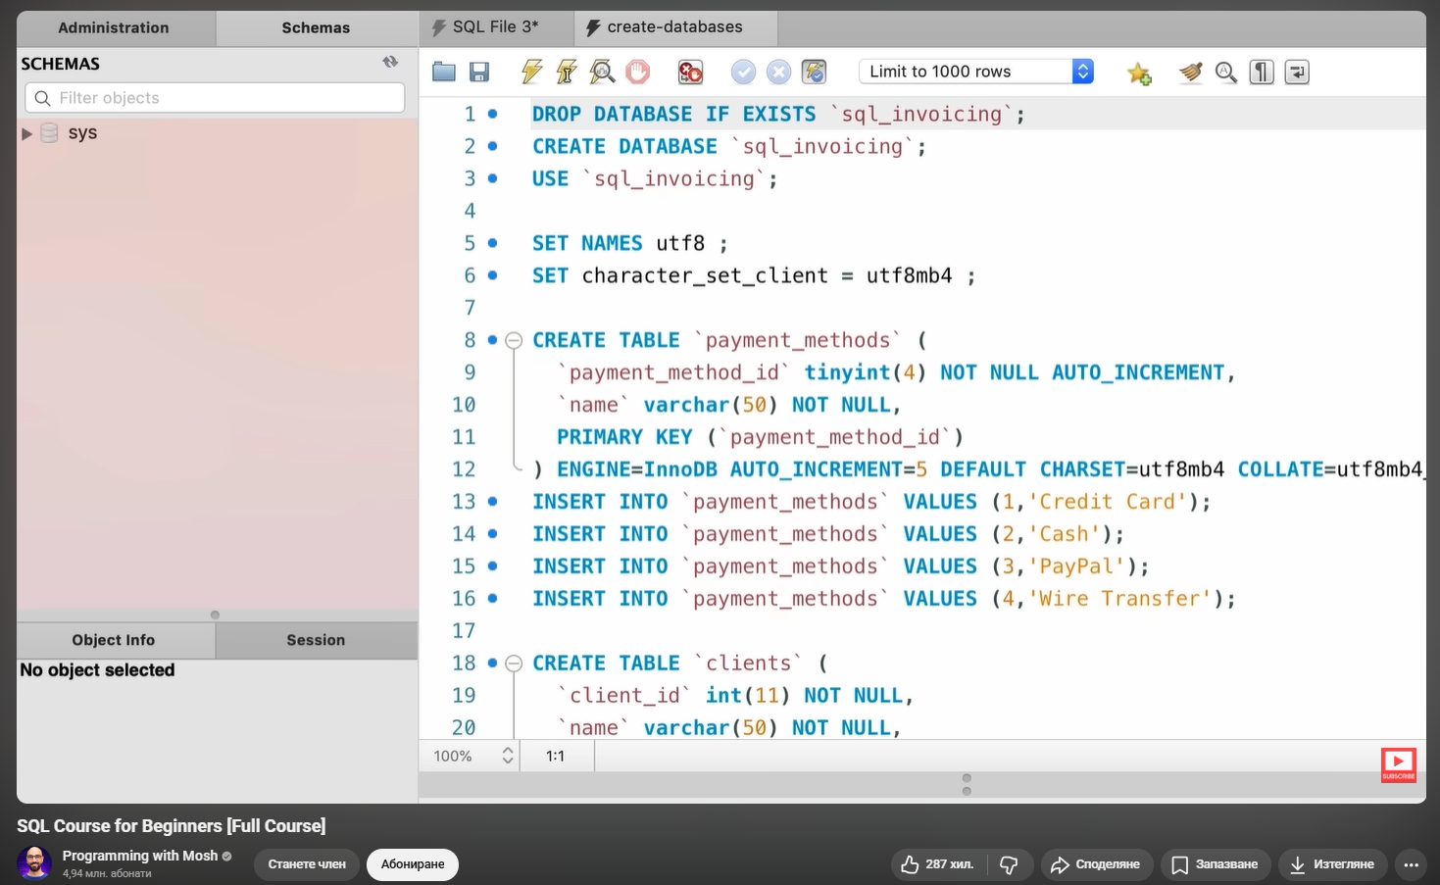
A
What are my goals?
1/1
The video that I watched:
SQL Course for Beginners [Full Course] - video course
Notes:
Describe your goals for this block using the SMARTER method. Make sure they are clear, relevant, have a measurable outcome, and can be recorded. Consider how well do they align with the role(s) you wish to take, and with the requirements given in the project brief. Think about the objectives you plan to choose, or that are mandated by the project. Are there any competencies that you need to focus on?
For each goal, find concrete examples of tasks you expect to undertake that will demonstrate this within the project for the block. Make sure the plan has an outcome that can be tracked and assessed. Make sure you have a clearly stated target for each goal. If you are unsure of how to demonstrate something, ask for help from your teachers.

Slide 9
Section B
B
Progress Log
Notes:
MUST BE UPDATED EVERY WEEK
This is simply a log (journal) of what you do each day, and what you learn from it. It is your responsibility to update this regularly and frequently. Be sure to include working links to any specific evidence you are referencing (and make sure that you share your docs with the teaching team). Note: some of the required information may be captured in production documents such as your work log or peer reviews.
In such cases, you simply need to provide links to those artifacts and may include any explanatory comment or reflection you feel is appropriate.
(Some reflection is almost always a good idea as it provides the foundation for Section C.)

Slide 10
1
Week 1 - Log
1/2
What did you do?
Reflection
What goal(s) did you set for this week?
The goal for the week was to get to know the business operations, the systems Move Group uses, and dive into the work environment.
What have you actually been able to do?
During the week I was successfully introduced to the business and it operations since I’ve been given comprehensive explanations and presentaions on how everything works.
Showcase what tasks you have been working on this week and provide evidence for it.
Completed Course in Move Academy
Being Itroduced to Ixolution and Transpas
Started working with Matilion and Snowflake
Business Understanding
How did the week go?
The week went pretty good because I was able to get to know about the business itself, its operations and what data they put inside the systems they use.
What went well?
Things that went well were learning how good are transported, what the process of receiving an order to finilizing it is, and data they use for all the processes.
What didn’t go so well?
Thing that didn’t go well was that I couldn’t go for a day with a truck driver so we’ll do it one of the next weeks.
What did you learn?
During the week I learnt a lot about how the business works, the TMS systems they use and how good are transported in the logistics sector
What could be added as an Action point looking forward to next week?
An action point for the next week is to get familiar of all the system they use, including both TMS, Matillion for Data Modelling, and Snowflake.

Slide 11
1
Week 1 - Feedback
2/2
manager, colleague, or team member feedback
Date: 12/09/2025
Feedback from: Sven Iliaens / Technical supervisor in Move Intermodal
Feedback: Everything is going well so far. Vladislav quickly got familiar with the company’s operations and systems, shows strong interest in understanding how logistics processes work, and asks relevant questions. He is adapting fast and shows initiative in learning new tools
Related to what task: Introduction to business operations and TMS systems overview.
Response/action coming forward from this: Continue exploring the systems (TMS, Matillion, Snowflake) and gradually start applying the knowledge to small data tasks and observations in the coming weeks.
Click for feedback delivery techniques!

Slide 12
2
Week 2 - Log
1/2
What did you do?
Reflection
What goal(s) did you set for this week?
An action point for this week is to get familiar of all the system they use, including both TMS, Matillion for Data Modelling, and Snowflake.
What have you actually been able to do?
During the week I was introduced to Matillion and Snowflake. We also looked further more in the TMS of Move and Van Dijk so now have better understanding of what’s inside of both TMS.
Showcase what tasks you have been working on this week and provide evidence for it.
Working with Matillion and Snowflake
Create first Data Vault view in Matillion
Being introduced to Data Vault 2.0 concepts
Explored that data coming from Transpas and Ixolution
How did the week go?
The week went well because I got familiar with all the systems they use, so it was a nice start.
What went well?
Things that went well were that we successfully made links between tables and a complete view in the Data Vault. We dived deeper in both TMS and it became more clear how they are using them.
What didn’t go so well?
Thing that didn’t go so well was that again I didn’t go for a day with a truck driver. Also we didn’t make a comprehensive analysis between the systems and their differences, but that’s for the next week.
What did you learn?
During the week I learnt about Matillion, Snowflake, Transpas, and the structure of creating the Data Model
What could be added as an Action point looking forward to next week?
As an Action point for the next week is to get to know more about Van Dijk KPIs for the reports and the Transpas TMS system they use, so I can start working on excluding the table from DB that I don’t need.

Slide 13
2
Week 2 - Feedback
2/2
manager, colleague, or team member feedback
Date: 19/09/2025
Feedback from: Sven Iliaens / Technical supervisor in Move Intermodal
Feedback: Vladislav continued to make very good progress this week. He is getting familiar with the main systems — TMS, Matillion, and Snowflake — and already understands the connection between the data tables and views. He is adapting quickly, asking the right questions, and shows a clear interest in how the Data Vault is structured. Everything is going smoothly.
Related to what task: Exploring TMS of Move and Van Dijk, and learning Matillion and Snowflake for data modelling.
Response/action coming forward from this: Continue exploring the TMS data structure and start identifying the tables and fields needed for Van Dijk KPI reporting and Data Vault modelling.

Slide 14
3
Week 3 - Log
1/2
What did you do?
Reflection
How did the week go?
The week went very well — I was able to start working on the connection of the business logic with the technical work in Matillion and Snowflake, which made the overall structure clearer.
What went well?
I successfully finalized the Rit view in Matillion and created several new links in Snowflake. The Van Dijk meeting gave valuable insight into how KPIs are calculated and used in reporting.
What didn’t go so well?
No major issues during the week. I could spend more time with the person that knows everything about the data in Van Dijk, but still we had a good time.
What did you learn?
I learnt how to use LNK and LSAT LNK links in Matillion, how to build a complete view, how Van Dijk defines KPIs in its logistics reports, and what is the day of a truck driver.
What could be added as an Action point looking forward to next week?
Next week’s goal is to start creating additional Matillion views based on Van Dijk’s KPI requirements and moving towards excluding all unnecessary tables.
What goal(s) did you set for this week?
As an Action point for the next week is to get to know more about Van Dijk KPIs for the reports and the Transpas TMS system they use, so I can start working on excluding the tables from DB that I don’t need and keep the relevant ones.
What have you actually been able to do?
During the week I met with the director of Van Dijk to explore the current manual reports and KPIs, continued working on the Rit view in Matillion, and linked several tables in Snowflake using LNK and LSAT LNK connections. I also went on a half-day trip with a truck driver to better understand the logistics process from order creation to delivery.
Showcase what tasks you have been working on this week and provide evidence for it.
Worked on the Rit view in Matillion and finalized the first complete view related to transport actions.
Checked and linked relevant tables in Snowflake for both Move and Van Dijk systems.
Attended meetings to analyze Van Dijk’s KPI reports and data sources.
Spent a half-day with a truck driver to gain hands-on insight into the operational workflow.

Slide 15
3
Week 3 - Feedback
2/2
manager, colleague, or team member feedback
Date: 23/09/2025
Feedback from: Tomas Tempelaars / Mentor at Move Intermodal
Feedback: Vladislav had another productive week, showing steady progress in connecting the business and technical aspects of the project. He successfully finalized the Rit view in Matillion, linked several tables in Snowflake, and actively participated in discussions about Van Dijk’s KPIs and reporting structure. It’s great to see how he combines practical understanding — like the half-day trip with the truck driver — with data modelling work. Everything is going very well.
Related to what task: Rit_view development in Matillion, linking tables in Snowflake, and KPI structure analysis for Van Dijk reports.
Response/action coming forward from this: Continue building additional views in Matillion based on KPI requirements, validate data across Van Dijk system, and deepen understanding of KPI logic for data needed for the reports.

Slide 16
4
Week 4 - Log
1/2
What did you do?
Reflection
What goal(s) did you set for this week?
Next week’s goal is to start creating additional Matillion views based on Van Dijk’s KPI requirements and moving towards excluding all unnecessary tables.
What have you actually been able to do?
During the week, I worked on linking tables in Matillion and Snowflake, created several connections for the Vracht and Dossier tables, and finalized the Vracht view. I also had multiple meetings — including with Tomas for a weekly update and with Sven to discuss and refine the overall internship planning. Additionally, I created a comprehensive plan for the entire placement, dividing it into five main phases.
Showcase what tasks you have been working on this week and provide evidence for it.
Worked on linking tables in Matillion and Snowflake.
Created links and finalized the Vracht view.
Started creating smaller tables linking to Vracht and Dossier.
Attended meetings with Tomas (weekly progress review) and Sven (planning discussion).
Made a complete plan for the internship divided into 5 phases.
Checked the Vracht table structure, which contained more than 100 columns, and analyzed its data availability.
Planning
How did the week go?
The week went very well — I managed to complete several important technical steps in Matillion and Snowflake and made significant progress on planning the next phases of the internship.
What went well?
Finalizing the Vracht view and creating links between related tables went smoothly. The meetings with Tomas and Sven were productive and helped align the future steps of the project.
What didn’t go so well?
The Vracht table turned out to have limited recent data so we are still exploring where is the remaining data for the past months and years.
What did you learn?
I learnt how to work with complex tables in Snowflake, create multi-table links in Matillion, and organize my work into a structured long-term plan.
What could be added as an Action point looking forward to next week?
An Action Point for the next week is to continue working on creating the relevant links in matillion, and hubs/sats/link for the tables needed, so at the end of the phase to have all required tables to build the report.

Slide 17
4
Week 4 - Feedback
2/2
manager, colleague, or team member feedback
Date: 30/9/2025
Feedback from: Tomas and Sven / Mentors at Move Intermodal
Feedback: Vladislav had another productive week. He finalized the Vracht view in Matillion, created new links between tables in Snowflake, and demonstrated a clear understanding of the overall data structure. He also showed strong initiative by preparing a detailed five-phase plan for the internship and discussing it with us to align next steps. His progress shows growing technical confidence and a structured approach to the project.
Related to what task: Finalizing the Vracht view, linking tables in Snowflake, and defining the internship planning.
Response/action coming forward from this: Continue building the relevant links in Matillion and create the necessary hubs, satellites, and links for the tables required in the upcoming reports, ensuring that by the end of this phase, all essential tables are ready for a creating Data Mart views.

Slide 18
5
Week 5 - Log
1/2
What did you do?
Reflection
What goal(s) did you set for this week?
The goal for this week was to continue building and linking the required tables for the vracht view, create the necessary hubs, satellites, links, and LSAT links, and further refine the existing views in Matillion.
What have you actually been able to do?
During the week, I worked extensively on linking tables to the vracht view and creating hubs, satellites, links, and LSAT links for all relevant tables. I made adjustments to the existing views based on feedback from meetings, managed and renamed views to follow the agreed structure, and experimented with historical data using the Vracht_Historie table. I also worked on Snowflake authentication issues and prepared communication regarding historical data.
Showcase what tasks you have been working on this week and provide evidence for it.
Created hubs, satellites, links, and LSAT links for more than 10 tables related to the vracht view.
Linked multiple tables to the vracht and dossier views in Matillion.
Adjusted and renamed views based on discussions with Tomas and Sven.
Prepared and sent a mail to Richard regarding historical data of the records.
Experimented with the Vracht_Historie table and added a new table to staging to explore data combination.
How did the week go?
The week went well and was very productive, with a strong focus on building the core data structures needed for the reporting views.
What went well?
Creating and linking the hubs, satellites, and links for the vracht-related tables went smoothly. The structure of the views became clearer, and the overall data model is now much more complete.
What didn’t go so well?
Richard has not responded to the mail yet regarding the historical data, which delayed clarification on how some older records should be handled.
What did you learn?
I learned how to efficiently build and manage multiple hubs, satellites, and link structures in Matillion, how to organize views consistently, and how historical tables can impact the design of reporting views.
What could be added as an Action point looking forward to next week?
The action point for next week is to finalize all remaining views and start working on the incremental logic of the data model.

Slide 19
5
Week 5 - Feedback
2/2
manager, colleague, or team member feedback
Date: 3 October 2025
Feedback from: Ben van Gerven (IT system developer and network administrator)
Feedback: Ben indicated that he is pleased with the progress made, so far. He appreciated the way the views were structured and the implementation of a clear naming convention to distinguish Transpas-related data. The changes made in the Matillion jobs and the example prepared in the Generate Tables component were seen as a good step towards maintaining clarity when linking data across different environments. Overall, the progress so far was considered very good.
Related to what task: Structuring and renaming views in Matillion, creating hubs, satellites, and links, and preparing the data model for data integration.
Response/action coming forward from this: Continue finalizing the remaining views and start working on the incremental logic, ensuring consistency across all environments and components.

Slide 20
6
Week 6 - Log
1/2
What did you do?
Reflection
What goal(s) did you set for this week?
The action point for next week is to finalize all remaining views and start working on the incremental logic of the data model.
What have you actually been able to do?
During the week, I integrated the vracht_historie table with the main vracht view and worked on combining multiple views into a single, more complete structure. I identified and resolved duplicate issues in the dossier_view and started setting up the incremental logic using load dates. I also participated in update meetings with Tomas, Sven, and the IT department.
Showcase what tasks you have been working on this week and provide evidence for it.
Integrated vracht_historie with the main vracht view.
Created and linked hubs, satellites, and links for staging tables.
Identified and resolved duplicate issues in the dossier_view.
Set up incremental logic using LOAD_DATE and LOAD_END_DATE.
Combined multiple main views into a single reporting-ready structure.
How did the week go?
The week went well and was technically intensive, with good progress on data integration and incremental processing.
What went well?
Integrating historical data and setting up the incremental logic went smoothly. Resolving the duplicate issue in the dossier_view improved overall data quality.
What didn’t go so well?
Scheduling a meeting with Richard was not possible due to limited availability, which delayed clarification on some open questions.
What did you learn?
I learned how to integrate historical data into existing views, implement incremental logic, and troubleshoot data duplication issues in complex views.
What could be added as an Action point looking forward to next week?
An action point for next week is to continue building and refining the data mart views, prepare production-ready reporting structures, and get introduced to Bold BI to start visualizing the data marts.

Slide 21
6
Week 6 - Feedback
2/2
manager, colleague, or team member feedback
Date: 13 October 2025
Feedback from: Tomas / Mentor at Move Intermodal
Feedback: This week, Vladislav made strong progress on the technical side of the project. He successfully integrated historical data into the main views, resolved duplicate issues in the dossier_view, and started implementing the incremental logic for the data processing. His ability to identify data quality issues and address them independently was clearly visible. Although it was not possible to schedule a meeting with Richard due to limited availability, this did not block progress, and Vladislav continued working effectively on the views and data model.
Related to what task: Integrating historical data, resolving data duplication issues, setting up incremental logic, and combining reporting views.
Response/action coming forward from this: Continue refining the incremental logic, finalize production-ready views, and begin working with data mart views and initial reporting in Bold BI.

Slide 22
7
Week 7 - Log
1/2
What did you do?
Reflection
What goal(s) did you set for this week?
An action point for next week is to continue building and refining the data mart views, prepare production-ready reporting structures, and get introduced to Bold BI to start visualizing the data marts.
What have you actually been able to do?
During the week, I continued working on combining the main vracht_dossier_rit views and started creating production-ready data mart views. I worked extensively on multiple data mart views, including Containers Amounts, Traincosts, and Loadingmeters per container. I also participated in update meetings with Tomas and Sven and worked on setting up the orchestration logic for running the views in the correct order.
Showcase what tasks you have been working on this week and provide evidence for it.
Continued combining all main views into a single, consolidated structure.
Started creating production-ready data mart views.
Built the Containers Amounts Data Mart View.
Built the Traincosts Data Mart View.
Created the Loadingmeters per container Data Mart View.
Set up the orchestration logic for running the data vault views in the correct sequence.
How did the week go?
The week went very well and was focused on transitioning from core data structures to reporting-oriented data mart views.
What went well?
Creating the data mart views progressed smoothly, and the orchestration setup helped ensure that the views can be executed in a controlled and accurate order.
What didn’t go so well?
There was not time for starting working with Bold Bi so its for the next week.
What did you learn?
I learned how to design and structure data mart views for reporting purposes and how to orchestrate view execution to ensure data consistency and correctness.
What could be added as an Action point looking forward to next week?
An action point for next week is to validate and test the data mart views, resolve any data inconsistencies, and start checking the report outputs, ensuring the data marts are ready for final use.

Slide 23
7
Week 7 - Feedback
2/2
manager, colleague, or team member feedback
Date: 20/10/25
Feedback from: Tomas / Mentor at Move Intermodal
Feedback: This week, Vladislav made clear progress in moving from core data structures to reporting-focused outputs. He successfully combined the main views into production-ready structures and created several data mart views, including Containers Amounts, Traincosts, and Loadingmeters per container. He also worked on setting up the orchestration logic to ensure the views run in the correct order. His work shows a good understanding of how the technical data model supports reporting requirements.
Related to what task: Combining main views, creating data mart views, and setting up orchestration for reporting.
Response/action coming forward from this: Continue validating and testing the data mart views, resolve any data inconsistencies, and start checking the report outputs to prepare for final reporting.

Slide 24
8
Week 8 - Log
1/2
What did you do?
Reflection
What goal(s) did you set for this week?
The goal for this week was to validate the results of the created data mart views, identify and resolve data inconsistencies, and prepare for in-depth discussions with stakeholders about the reported data.
What have you actually been able to do?
During the week, I focused on checking and testing the results of the existing data mart views by querying the data and comparing it with the report outputs. I worked on resolving differences and inconsistencies in the data, prepared structured questions for discussion, and attended an on-site meeting to go through the data and queries in detail.
Showcase what tasks you have been working on this week and provide evidence for it.
Checked and tested the results of the created data mart views.
Queried and analyzed data to identify inconsistencies between the data and the report.
Resolved and minimized differences in the data mart views.
Prepared a document with discussion points and questions for the on-site meeting.
Attended an on-site meeting to discuss the data and underlying queries.
Continued testing queries to validate the correctness of the views.
How did the week go?
The week went well and was strongly focused on data validation and quality checks.
What went well?
Testing queries and reviewing the data in detail helped identify inconsistencies early. The on-site meeting was valuable for clarifying how the data and queries should be interpreted.
What didn’t go so well?
Resolving differences between the data mart outputs and the report required multiple iterations, which took more time than expected.
What did you learn?
I learned how to systematically validate reporting data, compare query results with business reports, and prepare focused questions to efficiently discuss data issues with stakeholders.
What could be added as an Action point looking forward to next week?
An action point for next week is to continue querying and validating the data, minimize remaining differences, and start introducing the reporting layer using Bold BI.

Slide 25
8
Week 8 - Feedback
2/2
manager, colleague, or team member feedback
Date: 27 October 2025
Feedback from: Sven / Mentor Business Engineering
Feedback: This week, Vladislav focused on validating and testing the data mart views and resolving inconsistencies between the data and the report outputs. He worked thoroughly on querying and analyzing the data, prepared clear discussion points, and actively participated in the on-site meeting to review the data and underlying queries. His structured approach to testing and willingness to iterate on the views helped improve data quality and clarity. While resolving the differences required multiple iterations, steady progress was made throughout the week.
Related to what task: Testing and validating data mart views, resolving data inconsistencies, and reviewing report-related queries.
Response/action coming forward from this: Continue validating the remaining data differences and proceed with introducing the reporting layer in Bold BI.

Slide 26
9
Week 9 - Log
1/2
What did you do?
Reflection
What goal(s) did you set for this week?
An action point for next week is to continue querying and validating the data, minimize remaining differences, and start introducing the reporting layer using Bold BI.
What have you actually been able to do?
During the week, I focused on testing and querying the data to identify the relevant records and reduce discrepancies between the data mart views and the report. I reviewed other views used in the report, worked on excluding empty containers from the containers view, and participated in update meetings with Tomas and Sven. In addition, I started getting introduced to Bold BI, explored its features, and began rebuilding the report by connecting Snowflake data sources.
Showcase what tasks you have been working on this week and provide evidence for it.
Checked and reviewed other views used in the report.
Tested and queried data to find relevant records and minimize data differences.
Worked on improving the containers view by excluding empty containers.
Got introduced to Bold BI by reading documentation and exploring features.
Recreated the first view in Bold BI together with Sven.
Connected Snowflake data sources to Bold BI.
How did the week go?
The week went well and marked a transition from data validation to the reporting and visualization phase.
What went well?
Testing and querying the data helped bring the report outputs closer to the original results. The introduction to Bold BI and rebuilding the first report views went smoothly with guidance.
What didn’t go so well?
Despite improvements, there were still some remaining differences between the data mart outputs and the original report that required further investigation.
What did you learn?
I learned how to validate reporting data through querying, how to connect Snowflake data sources to Bold BI, and how to start rebuilding reports using a BI tool.
What could be added as an Action point looking forward to next week?
An action point for next week is to continue rebuilding the report in Bold BI, further reduce data differences, and validate the report outputs against the source data.

Slide 27
9
Week 9 - Feedback
2/2
manager, colleague, or team member feedback
Date: 3 November 2025
Feedback from: Tomas / Mentor at Move Intermodal
Feedback: This week, Vladislav made good progress in transitioning from data validation to the reporting phase. He continued testing and querying the data to minimize differences between the data mart views and the original report, and worked on improving the containers view by excluding empty records. He also started working with Bold BI, where he successfully connected Snowflake data sources and began rebuilding the report views. The collaboration with Sven during the initial Bold BI setup was effective and helped accelerate the reporting work.
Related to what task: Testing and querying data, reducing data discrepancies, and introducing the reporting layer in Bold BI.
Response/action coming forward from this: Continue rebuilding the report in Bold BI, further reduce remaining data differences, and validate the report outputs against the source data to ensure consistency and accuracy.

Slide 28
10
Week 10 - Log
1/2
What did you do?
Reflection
What goal(s) did you set for this week?
An action point for next week is to continue rebuilding the report in Bold BI, further reduce data differences, and validate the report outputs against the source data.
What have you actually been able to do?
During the week, I worked on rebuilding the report structure in Bold BI and created several widgets, including loading meters per container and subcontractors in IT and NL. Since the SQL queries from Transpas were not yet available, I experimented with different SQL queries for the data mart views and explored the Transpas TMS system to locate the relevant queries. I also had multiple meetings with Sven to discuss where the SQL queries could be found and how to align the Move dataset with Transpas data. Additionally, I prepared a detailed email to Richard from Van Dijk explaining which SQL queries were needed to complete the reports.
Showcase what tasks you have been working on this week and provide evidence for it.
Rebuilt the report structure in Bold BI.
Created report widgets for loading meters per container, subcontractors.
Experimented with SQL queries for the data mart views.
Explored SQL queries in the Transpas TMS system.
Followed a youtube course on SQL data manipulation to support the mapping work.
Company_Evaluation_Form_Week_10
Watched a youtube video - SQL Course for Beginners
How did the week go?
The week went well and was focused on progressing the reporting layer while addressing data extraction challenges.
What went well?
Rebuilding the report in Bold BI and creating the report widgets progressed smoothly. The discussions with Sven helped clarify where and how the required SQL queries could be obtained.
What didn’t go so well?
The lack of available SQL queries from Transpas slowed down the completion of the data mart views, requiring additional investigation and experimentation.
What did you learn?
I learned how to rebuild reports in Bold BI, design report widgets, explore SQL queries within a TMS system, and align datasets between different systems.
What could be added as an Action point looking forward to next week?
An action point for next week is to obtain the required SQL queries from Transpas, finalize the data mart views, and continue refining the report in Bold BI using validated data.

Slide 29
10
Week 10 - Feedback
2/2
manager, colleague, or team member feedback
Date: 10 November 2025
Feedback from: Sven and Tomas
Feedback: During Week 10, Vladislav continued to show strong technical engagement and made good progress on rebuilding the report in Bold BI and working on the required data structures. His collaboration with the internal team was evaluated very positively, and his communication during meetings was clear and constructive. From a technical perspective, he works independently and demonstrates a good level of problem-solving ability, especially when experimenting with SQL queries and aligning data between systems. One point for further improvement is to involve external stakeholders more proactively when information is missing or unclear, particularly when dependencies exist on external systems or data providers. Overall, Vladislav is perceived as a pleasant and calm team member with good work ethics, who approaches tasks in a structured and professional manner.
Related to what task: Rebuilding the report in Bold BI, experimenting with SQL queries for data mart views, and aligning data sources between systems. Company evaluation form.
Response/action coming forward from this: Increase proactive involvement of relevant stakeholders when external input is needed, continue strengthening independence in technical decision-making, and finalize report development once the required SQL queries are available.

Slide 30
You are halfway there!
You are now halfway your placement period, congratulations! Hopefully, you have learned a lot already by now and you have found your way around the company and the team you are working with. As a reminder, do not forget about the following deliverables:
Remind your company supervisor about the 10th week assessment. They should fill in the assessment sheet provided and discuss their outcomes with you. Reflect on their feedback and see how you can improve yourself for the second half of your placement period. Afterwards, your supervisor needs to send the signed version to your BUas supervisor! ​ ​
Plan a meeting with your Buas supervisor to discuss the progress of your placement.
Do not forget to update your learning log! Make sure that the log is accessible for your Buas supervisor so they can have a look at your progress.
Start writing on your report; check Brightspace for the guidelines.
Above all, don’t be shy! Ask all the questions that pop up and have coffee with your coworkers to learn about their career path and their education. You are there to learn, make the most of it!

Slide 31
11
Week 11 - Log
1/2
What did you do?
Reflection
What goal(s) did you set for this week?
The goal for this week was to resolve access issues, restore the working environment, and continue progressing with data mapping and the creation of a new data mart view.
What have you actually been able to do?
At the start of the week, I faced significant access issues related to the VPN and connecting to Matillion, which blocked productive work for a full day. Together with Sven and the IT administrators, the issue was investigated and resolved by accessing Matillion through the virtual environment of Ixolution (MOVE’s TMS system). Once access was restored, I continued working on data mapping, focusing on column renaming, and started developing a new data mart view to serve as the source for the mapping on a dossier (order) level.
Showcase what tasks you have been working on this week and provide evidence for it.
Investigated and resolved VPN and Matillion access issues in collaboration with IT and Sven.
Restored access to Matillion via the Ixolution virtual environment.
Continued working on data mapping, focusing on column renaming.
Started developing a new data mart view as the source for the mapping.
Defined the data mart view at a dossier (order) level.
How did the week go?
The week started with technical difficulties, but once the access issues were resolved, progress continued as planned.
What went well?
Resolving the access issue allowed work to continue without further interruptions. The progress on data mapping and the creation of a new data mart view helped stabilize the foundation for the next phase.
What didn’t go so well?
The VPN and Matillion access problems caused a full day of delay and required additional coordination with IT.
What did you learn?
I learned how to troubleshoot access issues in a corporate IT environment, work with virtual environments to regain access, and further refine data mapping at a detailed, order-level granularity.
What could be added as an Action point looking forward to next week?
An action point for next week is to continue expanding the data mapping with additional calculated columns and further develop the data mart views to support the reporting requirements.

Slide 32
11
Week 11 - Feedback
2/2
manager, colleague, or team member feedback
Date: 17 November 2025
Feedback from: Tomas / Mentor at Move Intermodal
Feedback: This week, Vladislav handled an unexpected technical setback in a professional and proactive manner. He encountered VPN and Matillion access issues that blocked work at the start of the week, but worked closely with Sven and the IT administrators to identify and resolve the problem. Once access was restored through the Ixolution virtual environment, he quickly resumed his tasks and made solid progress on data mapping and the development of a new data mart view at dossier level. His ability to stay focused and productive after the disruption reflects good problem-solving skills and resilience.
Related to what task: Resolving access issues, restoring the working environment, data mapping, and creating a new data mart view.
Response/action coming forward from this: Continue expanding the data mapping with additional calculated columns and further develop the data mart views to support the next reporting phase.

Slide 33
12
Week 12 - Log
1/2
What did you do?
Reflection
What goal(s) did you set for this week?
The goal for this week was to continue and deepen the data mapping process by creating calculated columns, handling date-related logic, and enriching the dataset with additional derived attributes required for reporting.
What have you actually been able to do?
During the week, I worked extensively on data mapping and calculations. I created multiple new calculated columns for dates, time-related metrics, and status fields, such as shipment months, years, quarters, lead times, arrival and departure times, and client-related statuses. I also added and mapped a new reference table (REF_LANE) and ensured the correct joins and mappings between the calculated data and the new table. Additionally, I participated in update meetings with mentors and Sven to align on progress and next steps.
Showcase what tasks you have been working on this week and provide evidence for it.
Created calculations for country codes and zip codes.
Built date-based derived columns (e.g. shipment month, year, quarter).
Implemented lead-time and duration calculations (e.g. actual lead time, requested lead time, arrival and unloading times).
Created and mapped multiple new calculated columns related to status and timing.
Added and joined the REF_LANE table to enrich the dataset.
How did the week go?
The week went very well and was highly focused on detailed data transformation and enrichment.
What went well?
Creating and validating calculated columns progressed smoothly, and the addition of the reference table improved the structure and completeness of the dataset.
What didn’t go so well?
Some calculations required multiple iterations to ensure correctness, especially those involving date and time logic.
What did you learn?
I learned how to design complex calculated columns, work with time-based logic in data transformations, and integrate reference tables into an existing data model.
What could be added as an Action point looking forward to next week?
An action point for next week is to validate the mapped and calculated fields through data checks, refine the joins and expressions where needed, and prepare the dataset for further integration into reporting views.

Slide 34
12
Week 12 - Feedback
2/2
manager, colleague, or team member feedback
Date: 25 November 2025
Feedback from: Sven / Business Engineering Mentor at Move
Feedback: This week, Vladislav made strong progress in the data mapping phase by implementing a wide range of calculated columns and enriching the dataset with additional derived attributes. He worked thoroughly on date- and time-based calculations, lead-time metrics, and status-related fields, and successfully integrated the REF_LANE reference table into the data model. His structured approach to complex calculations and careful handling of joins contributed positively to the quality and consistency of the data. Communication during update meetings remained clear and effective.
Related to what task: Data mapping, creation of calculated columns, integration of reference tables, and data enrichment.
Response/action coming forward from this: Proceed with validating the calculated and mapped fields through detailed data checks, refine joins and expressions where needed, and prepare the dataset for integration into reporting views.

Slide 35
13
Week 13 - Log
1/2
What did you do?
Reflection
What goal(s) did you set for this week?
The goal for this week was to refine the vracht_rit view to ensure correct granularity, extend the data mapping with additional calculated fields, and perform thorough data checks to validate the results.
What have you actually been able to do?
During the week, I adjusted the source of the vracht_rit view to ensure there is only one record per dossier and worked on creating a separate join to correctly retrieve the costs per dossier. I continued with data mapping by adding multiple calculated columns related to shipment details, time-based metrics, and address information. I also added an additional reference table (REF_HUB) and performed data checks to verify that the mapped values match the provided data samples. Meetings with mentors and the IT team were used to align progress and confirm the correctness of the approach.
Showcase what tasks you have been working on this week and provide evidence for it.
Adjusted the vracht_rit view source to ensure one record per dossier.
Created a separate join on vracht_rit to correctly calculate and retrieve costs per dossier.
Performed data checks to verify link correctness and data accuracy.
Added multiple calculated columns (e.g. shipment type, menu type, sales type, office code, number of shipments).
Added and mapped the REF_HUB reference table.
Created complex expressions for time-based calculations (departure/arrival times, delivery ranges, unloading terms).
How did the week go?
The week went very well and was focused on refining data accuracy and improving the correctness of the reporting logic.
What went well?
Ensuring one record per dossier and separating the cost calculations significantly improved data consistency. The additional mappings and reference tables strengthened the overall data model.
What didn’t go so well?
Some calculations required careful validation and multiple iterations to ensure the results matched the expected business logic.
What did you learn?
I learned how to control data granularity in complex views, design separate joins for accurate cost allocation, and validate mappings through systematic data checks.
What could be added as an Action point looking forward to next week?
An action point for next week is to continue refining cost calculations, further clean and standardize mapped values, and prepare the data model for final reporting and validation.

Slide 36
13
Week 13 - Feedback
2/2
manager, colleague, or team member feedback
Date: 1 December 2025
Feedback from: Tomas / Mentor at Move Intermodal
Feedback: This week, Vladislav made solid progress in refining the data model and improving data accuracy. He successfully adjusted the vracht_rit view to ensure a single record per dossier and implemented a separate join to correctly calculate costs at dossier level. He also extended the data mapping with multiple calculated fields and integrated an additional reference table to enrich the dataset. The data checks performed throughout the week helped confirm that the mapped values align with the provided data samples. His structured and detail-oriented approach contributed positively to the stability and correctness of the reporting logic.
Related to what task: Refining the vracht_rit view, implementing cost calculations, extending data mapping, and validating data through checks.
Response/action coming forward from this: Continue refining cost calculations, standardize mapped values where needed, and prepare the data model for final validation and reporting.

Slide 37
14
Week 14 - Log
1/2
What did you do?
Reflection
What goal(s) did you set for this week?
The goal for this week was to standardize and clean mapped values, extend the data model with additional links, and implement cost calculations at dossier level for both train and trucking transport.
What have you actually been able to do?
During the week, I focused on cleaning and renaming values across multiple columns to ensure consistency, particularly for station names, addresses, and related attributes. I continued working on data mapping by mapping columns and values for company names, trade names, city and address fields, shipment status, and shipment sequence. In addition, I added new links to the dossier_view to enable cost calculations per dossier. I implemented train cost calculations and trucking cost calculations (both South and North), creating SQL logic at rit level and distributing costs to dossiers based on weight.
Showcase what tasks you have been working on this week and provide evidence for it.
Renamed and standardized values in columns related to station names and addresses.
Continued data mapping for company names, trade names, cities, addresses, shipment status, and shipment sequence.
Added additional links from rit_view to dossier_view to support cost calculations.
Implemented train cost, trucking south and north calculations at rit level and distributed costs to dossiers based on weight.
How did the week go?
The week went very well and was focused on improving data quality and implementing accurate cost allocation logic.
What went well?
Standardizing values significantly improved data consistency, and the implementation of cost calculations added important financial insight at dossier level.
What didn’t go so well?
Some cost calculations required additional validation to ensure the weight-based distribution logic produced correct results.
What did you learn?
I learned how to clean and standardize mapped values at scale, implement cost allocation logic across different transport modes, and design SQL-based calculations that distribute costs accurately at dossier level.
What could be added as an Action point looking forward to next week?
An action point for next week is to validate all cost calculations through detailed data checks, refine the financial logic where needed, and continue extending the data model with additional calculated metrics.

Slide 38
14
Week 14 - Feedback
2/2
manager, colleague, or team member feedback
Date: 8 December 2025
Feedback from: Sven / Business Engineering Mentor at Move
Feedback: This week, Vladislav showed strong attention to detail while improving data quality and implementing cost calculations. He worked systematically on standardizing mapped values across multiple columns, which increased consistency and readability of the data. In addition, he successfully added the required links to enable cost calculations at dossier level and implemented train and trucking cost logic using weight-based distribution. His approach to handling financial logic and validating the results demonstrates a good understanding of both the technical and business aspects of the data.
Related to what task: Standardizing mapped values, extending data links, and implementing train and trucking cost calculations at dossier level.
Response/action coming forward from this: Continue validating and refining the cost calculations, perform additional data checks, and further extend the data model with financial and performance-related metrics.

Slide 39
15
Week 15 - Log
1/2
What did you do?
Reflection
What goal(s) did you set for this week?
The goal for this week was to continue and finalize data mapping related to financial data, create calculations for costs and revenues, and validate that all financial figures are mapped and calculated correctly at dossier level.
What have you actually been able to do?
During the week, I worked extensively on data mapping and financial calculations. I added new columns with calculation formulas for margins and costs/revenues, and created new calculations for chargeable weight based on actual weight, loading meters, and cubic meters. I also linked a new table to the dossier_view to introduce the correct financial date (datum_aangemaaks), which is required for financial reporting. Additionally, I created expressions for cost and revenue calculations based on financial data and performed multiple data checks to ensure that all costs and revenues are mapped accurately.
Showcase what tasks you have been working on this week and provide evidence for it.
Continued data mapping for financial-related columns.
Added new calculated columns for margins and cost/revenue formulas.
Created calculations for chargeable weight based on actual weight, loading meters, and cubic meters.
Linked a new table to dossier_view to retrieve datum_aangemaaks as the financial date.
Created expressions for financial calculations (costs and revenues).
Performed data checks to verify that costs and revenues are mapped and calculated accurately.
How did the week go?
The week went well and was focused on completing financial logic and validating the correctness of the mapped data.
What went well?
The creation of financial calculations and the introduction of the correct financial date improved the reliability of the reporting data. Data checks helped confirm the accuracy of the mappings.
What didn’t go so well?
Some financial calculations required careful validation and multiple checks to ensure all values were correctly aligned across tables.
What did you learn?
I learned how to implement financial calculations within a data model, handle chargeable weight logic, and validate cost and revenue figures through structured data checks.
What could be added as an Action point looking forward to next week?
An action point for next week is to finalize remaining data formatting tasks, resolve any outstanding data inconsistencies, and prepare the dataset for final reporting and validation.

Slide 40
15
Week 15 - Feedback
2/2
manager, colleague, or team member feedback
Date: 15 December 2025
Feedback from: Tomas and Sven / Mentors at Move Intermodal
Feedback: During Week 15, Vladislav made strong progress in completing the financial data mapping and implementing cost and revenue calculations. He worked accurately on adding new calculated columns for margins, costs, and revenues, and successfully implemented chargeable weight logic based on multiple parameters such as actual weight, loading meters, and cubic meters. The introduction of the correct financial date through linking an additional table to the dossier_view was an important improvement for financial reporting. His attention to detail during data checks helped ensure that the calculated financial figures are reliable and correctly mapped.
Related to what task: Financial data mapping, creation of cost and revenue calculations, chargeable weight logic, and data validation.
Response/action coming forward from this: Finalize remaining data formatting tasks, resolve any outstanding inconsistencies, and prepare the dataset for final reporting and validation in the next phase.

Slide 41
16
Week 16 - Log
1/2
What did you do?
Reflection
What goal(s) did you set for this week?
The goal for this week was to finalize the remaining data mapping and formatting tasks, resolve data quality issues such as duplicates and irrelevant records, and align the data and report structure with Van Dijk and Transpas requirements.
What have you actually been able to do?
During the week, I focused on finalizing the last touches of data mapping and continued working on data formatting to improve data quality. I identified and handled irrelevant records and duplicates in the Dossier_view. I also prepared for and attended a meeting with Richard from Van Dijk, where we discussed open questions related to the data and reporting logic and received guidance on how to handle irrelevant results. In addition, I coordinated with the IT team to provide updates and prepared emails to Transpas support and Dianne to clarify calculation logic needed for price division and reporting.
Showcase what tasks you have been working on this week and provide evidence for it.
Finalized last touches of data mapping.
Continued data formatting to clean and structure the dataset.
Identified and resolved irrelevancies and duplicates in the Dossier_view.
Prepared a structured document with discussion points for the Van Dijk meeting.
Met with Richard from Van Dijk to discuss data and reporting questions.
Continued resolving remaining mapping and formatting issues.
How did the week go?
The week went well and was focused on consolidation, validation, and alignment with business stakeholders.
What went well?
The meetings with Van Dijk and the IT team helped clarify open questions and validate the approach. Progress on cleaning duplicates and irrelevant data improved overall data quality.
What didn’t go so well?
Some issues required additional follow-up with external parties, which slightly slowed down finalization.
What did you learn?
I learned how to handle late-stage data quality issues, align technical solutions with business expectations, and communicate effectively with multiple stakeholders.
What could be added as an Action point looking forward to next week?
An action point for next week is to resolve the remaining data mart issues, finalize report views, and continue validating the output in preparation for final reporting.

Slide 42
16
Week 16 - Feedback
2/2
manager, colleague, or team member feedback
Date: 22 December 2025
Feedback from: Sven / Business Engineering Mentor at Move Intermodal
Feedback: During Week 16, Vladislav focused on consolidating and validating the work completed in earlier phases. He successfully finalized the remaining data mapping and formatting tasks and took a structured approach to identifying and resolving duplicates and irrelevant records in the Dossier_view. His preparation for the meeting with Van Dijk was thorough, and the discussion with Richard helped clarify several open questions regarding data interpretation and reporting logic. Vladislav also communicated proactively with the IT team and Transpas support to resolve outstanding calculation and data quality topics. Overall, his work this week contributed significantly to stabilizing the dataset and aligning it with business expectations.
Related to what task: Final data mapping and formatting, resolving duplicates and data inconsistencies, stakeholder alignment with Van Dijk and IT, and preparation for final reporting.
Response/action coming forward from this: Resolve the remaining data mart and reporting issues, finalize report views, and continue validating the output to prepare for the final reporting phase.

Slide 43
17
Week 17 - Log
1/2
What did you do?
Reflection
How did the week go?
The week went well and was very productive, with a strong focus on finalizing, validating, and improving the quality of the data.
What went well?
Finalizing the data mapping and resolving data inconsistencies went smoothly. The meeting with Van Dijk was valuable and helped clarify open questions about the report and the underlying data.
What didn’t go so well?
Some data issues required more time than expected due to unclear calculations and historical data limitations, which required additional investigation and communication.
What did you learn?
I learned how to identify and resolve data inconsistencies in reporting views, how to handle duplicates and irrelevant data effectively, and how to communicate data-related questions clearly with both technical and business stakeholders.
What could be added as an Action point looking forward to next week?
As an Action Point for the next week is to update the changes disscussed with Van Dijk. Start the report for university and working on the views in the report
What goal(s) did you set for this week?
The goal for this week was to finalize the remaining data mapping and formatting, resolve inconsistencies and duplicates in the views, and prepare for validation of the report data with Van Dijk and internal stakeholders.
What have you actually been able to do?
During the week, I finalized the last parts of the data mapping, continued working on data formatting, and resolved issues related to duplicates and irrelevant records in the Dossier view. I also prepared for and attended meetings with mentors and Van Dijk to discuss the report structure, data logic, and open questions.
Showcase what tasks you have been working on this week and provide evidence for it.
Finalized the last touches of data mapping.
Continued data formatting and cleanup in the views.
Identified and resolved duplicates and irrelevant records in the Dossier view.
Prepared a structured list of questions and discussion points for Van Dijk.
Attended a meeting with Richard from Van Dijk to discuss report data, logic, and inconsistencies.
Prepared and sent emails to Transpas support and Van Dijk regarding calculation logic and report-related questions.
Spent the remaining time resolving open issues in the mapping and views.

Slide 44
17
Week 17 - Feedback
2/2
manager, colleague, or team member feedback
Date: 20 December 2025
Feedback from: Tomas / Mentor at Move Intermodal
Feedback: This week, Vladislav focused on finalizing and validating the data used for reporting. He completed the remaining data mapping tasks, worked thoroughly on data formatting, and addressed inconsistencies and duplicates in the Dossier view. His preparation for the meeting with Van Dijk was well structured, which led to productive discussions about data logic, calculations, and report accuracy. He also showed good ownership by actively following up on open questions with both Van Dijk and Transpas support. Overall, his work reflects a strong attention to detail and a solid understanding of both the technical and business aspects of the reporting process.
Related to what task: Final data mapping, data formatting, resolving data issues, and validating report logic with stakeholders.
Response/action coming forward from this: Proceed with resolving the remaining open data questions, validate the final report outputs with stakeholders.

Slide 45
18
Week 18 - Log
1/2
What did you do?
Reflection
What goal(s) did you set for this week?
The goal for this week was to implement the changes discussed with Van Dijk, start working on the university report, and continue improving the data mart views used in the report.
What have you actually been able to do?
During the week, I focused on updating and validating the data mart views by investigating duplicates in the vracht_rit view and experimenting with aggregation logic to improve data quality. I also continued working on the views that will be used in the report and had an update meeting with my mentors to align on progress.
Showcase what tasks you have been working on this week and provide evidence for it.
Updated data mart views based on discussions with Van Dijk.
Investigated the source of duplicates in the vracht_rit view.
Experimented with aggregation logic to reduce duplicate records.
Continued working on report-related views.
Attended an update meeting with mentors to discuss progress and next steps.
How did the week go?
The week went well, with focused progress on implementing feedback from Van Dijk and improving the quality of the data used in the report.
What went well?
Analyzing duplicates and refining aggregation logic helped clarify how the data mart views should be structured. The mentor update meeting helped confirm the approach.
What didn’t go so well?
Progress was slightly limited due to the holiday period, which reduced the number of working days available.
What did you learn?
I learned how to adjust data mart views based on stakeholder feedback and how aggregation logic can impact data quality and reporting accuracy.
What could be added as an Action point looking forward to next week?
Continue finalizing and validating the remaining data mart views and report outputs, further improve data consistency (especially around dossier-level records), and continue writing and refining the internship portfolio based on feedback and progress made so far.

Slide 46
18
Week 18 - Feedback
2/2
manager, colleague, or team member feedback
Date: 2 January 2026
Feedback from: Sven / Mentor at Move Intermodal
Feedback: During this week, Vladislav focused on implementing the changes discussed with Van Dijk and improving the quality of the data used in the report. He worked on analysing and resolving duplicates in the data mart views, particularly in the vracht_rit view, and experimented with aggregation logic to improve consistency. He also maintained clear communication with his mentors through regular update meetings. Despite the limited working days due to the holiday period, meaningful progress was made on both the views and the preparation for the report.
Related to what task: Updating data mart views, resolving duplicate records, applying stakeholder feedback, and preparing report-related views.
Response/action coming forward from this: Finalize the updated data mart views, validate the corrected outputs, and continue working on the university report and report views.

Slide 47
19
Week 19 - Log
1/2
What did you do?
Reflection
What goal(s) did you set for this week?
The goal for this week was to continue working on the data mart views, resolve remaining data consistency issues, and make progress on the internship portfolio and preparation for the BUas comeback day presentation.
What have you actually been able to do?
During the week, I worked further on the data mart views, resolved duplicate issues within Dossier records, and applied final improvements to the data mapping. In parallel, I continued writing the internship portfolio, including the introduction and project timeline sections, and prepared the presentation for the BUas comeback day. I also attended update meetings and participated in the presentation day.
Showcase what tasks you have been working on this week and provide evidence for it.
Continued working on and refining data mart views.
Resolved duplicate records within Dossier data and ensured one record per dossier.
Applied final changes to the data mapping and excluded irrelevant columns.
Worked on the internship portfolio (introduction and project planning sections).
Prepared and presented slides for the BUas comeback day.
Created additional data mart views and report views in Bold BI.
Comeback_Day_Presentation
How did the week go?
The week went well and was productive, with a good balance between technical work, documentation, and presentation-related tasks.
What went well?
Resolving the duplicate issues and finalizing parts of the data mapping went smoothly. The progress on the portfolio and the comeback day presentation helped structure the final phase of the internship.
What didn’t go so well?
Switching between technical work and writing tasks required careful time management, but all planned activities were completed.
What did you learn?
I learned how to finalize data mart views with a focus on data consistency, how to clearly document a technical project in an academic portfolio, and how to present progress and results effectively.
What could be added as an Action point looking forward to next week?
An action point for next week is to finalize the internship portfolio, work log, and learning log, and ensure that all deliverables are completed and submitted on time.

Slide 48
19
Week 19 - Feedback
2/2
manager, colleague, or team member feedback
Date: 9 January 2026
Feedback from: Tomas / Mentor at Move Intermodal
Feedback: This week, Vladislav successfully combined technical finalization work with documentation and presentation tasks. He resolved remaining duplicate issues in the Dossier data, applied final improvements to the data mapping, and continued refining the data mart views and report outputs. In parallel, he made solid progress on the internship portfolio and prepared and delivered the BUas comeback day presentation. His ability to manage multiple deliverables in parallel and maintain focus on both technical accuracy and clear documentation demonstrates strong organization and commitment during the final phase of the internship.
Related to what task: Finalizing data mart views, resolving data consistency issues, portfolio writing, and preparation for the BUas comeback day.
Response/action coming forward from this: Finalize the internship portfolio, work log, and learning log, and ensure all remaining deliverables are completed and submitted on time.

Slide 49
20
Week 20 - Log
1/2
What did you do?
What goal(s) did you set for this week?
The goal for the final week of the internship was to finalize all remaining technical work, validate the reports, complete the portfolio and learning logs, and conclude the internship with aligned and validated results.
What have you actually been able to do?
During the final week, I focused on completing both the technical and academic deliverables. I finalized several sections of the portfolio, including the project timeline, company description, methodology, evaluation, testing, discussion, and conclusion sections. I continued working on creating and extending data mart views in Matillion and integrated them into Bold BI. I validated the reports together with the Van Dijk reporting team and mentors, performed report checks to identify and resolve remaining issues, and set up the generate tables and schedulers to ensure automated daily updates of the views. The week concluded with final validation meetings and confirmation of the internship results.
Showcase what tasks you have been working on this week and provide evidence for it.
Wrote multiple portfolio sections (project timeline, company description, methodology, evaluation, testing, discussion, and conclusion).
Created additional data mart views in Matillion for loading meters, containers, outsourced costs, and tons in Belgium.
Integrated data mart views into Bold BI and created corresponding data sources.
Performed report checks and validated report results.
Met with the Van Dijk reporting team to validate the report outputs.
Set up generate tables and schedulers for automatic daily updates of the views.
Portfolio , Company_Evaluation_Form_Week_20
Reflection
How did the week go?
The final week went very well and was focused on finalization, validation, and closure of the internship.
What went well?
All technical components were successfully finalized and validated, and the reports were aligned with business expectations. The portfolio and documentation were completed on time, and the automated scheduling ensured the sustainability of the solution.
What didn’t go so well?
The workload was high due to the combination of technical finalization and academic writing, but all tasks were completed within the planned timeframe.
What did you learn?
I learned how to finalize and validate a complex data project, coordinate technical and business validation, and document a full end-to-end internship project in a structured academic portfolio.
What could be added as an Action point looking forward to next week?
As this was the final week of the internship, the action point is to submit all deliverables to the university on time and reflect on the overall learning outcomes of the internship.

Slide 50
20
Week 20 - Feedback
2/2
manager, colleague, or team member feedback
Date: 20 January 2026
Feedback from: Sven Iliaens / Tomas Tempelaars – Mentors at Move Intermodal
Feedback: During the internship period, Vladislav delivered a good and valuable result for Move Intermodal and Van Dijk. He demonstrated a solid understanding of the professional practice, including company processes, data flows, and the operational context of the logistics domain. His technical competence developed strongly over the course of the internship; after an initial period of guidance and self-study, he was able to work fully independently on the technical implementation and data modelling tasks. Vladislav showed strong problem-solving skills and critical thinking within the scope of the assignment and the existing system structure. The quality of his technical work was consistently high from the early stages of the internship through to the final deliverables. He proved adaptable when priorities changed and adjusted his planning accordingly, which was particularly important given the transition phase within the Van Dijk team during the project. Collaboration with the internal Move team was very good. Communication with the Van Dijk team was more challenging due to remote working conditions and ongoing organizational changes, but Vladislav demonstrated improvement in communication and escalation during the second half of the internship. Ultimately, the required information was obtained and integrated into the solution. If this information had been available earlier, further optimization could have been achieved; nevertheless, the current end result is already strong and meets expectations. Overall, Vladislav is described as a pleasant and calm colleague with good work ethics, strong technical independence, and a professional attitude. The company is satisfied with the outcome of the internship and the contribution delivered.
Related to what task: End-to-end delivery of the internship project, including data modelling, reporting, stakeholder communication, and final validation of results.
Response/action coming forward from this: Continue developing project communication and follow-up skills alongside strong technical independence, especially in environments with multiple stakeholders and remote collaboration. Build on the solid technical foundation demonstrated during this internship.

Slide 51
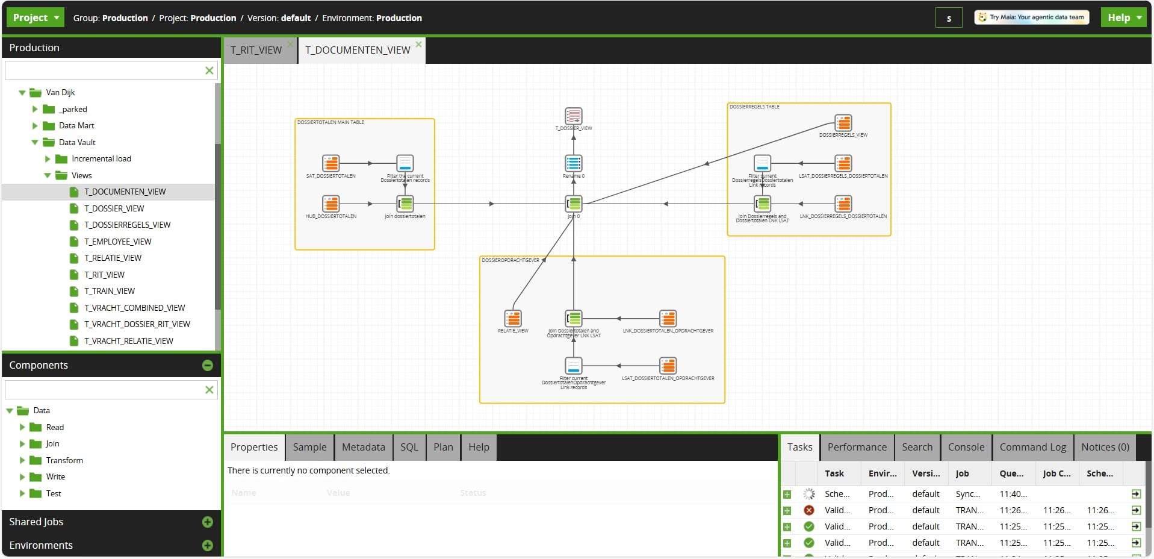
20
Week 20 - Evidencing
1/6
Example of views created in Matillion

Slide 52
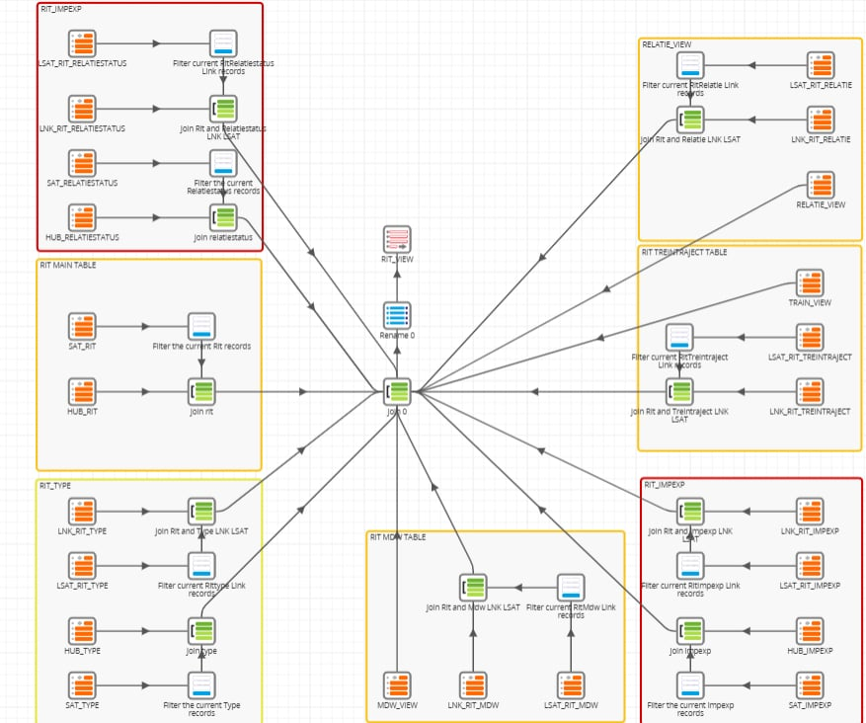
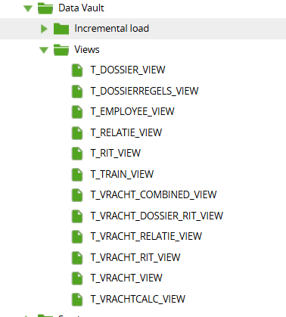
20
Week 20 - Evidencing
2/6
Example of views created in Matillion
All Data Vault views created in Matillion

Slide 53
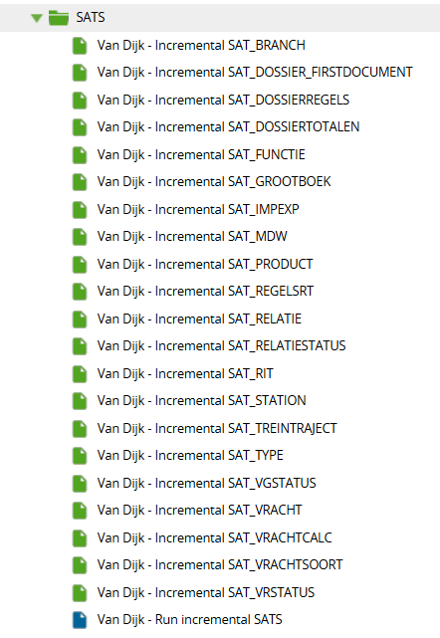
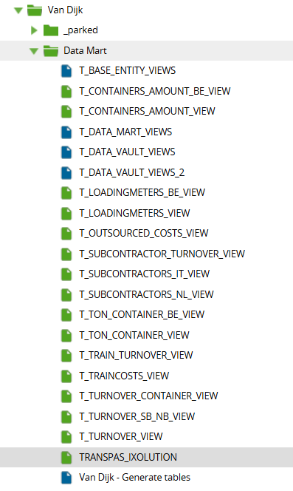
20
Week 20 - Evidencing
3/6
All Sats of all tables used in Matillion
All Data Mart views created in Matillion

Slide 54

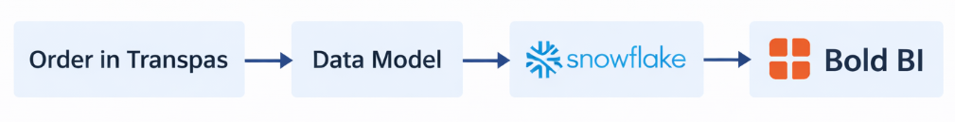
20
Week 20 - Evidencing
4/6
Data Flow Example

Slide 55
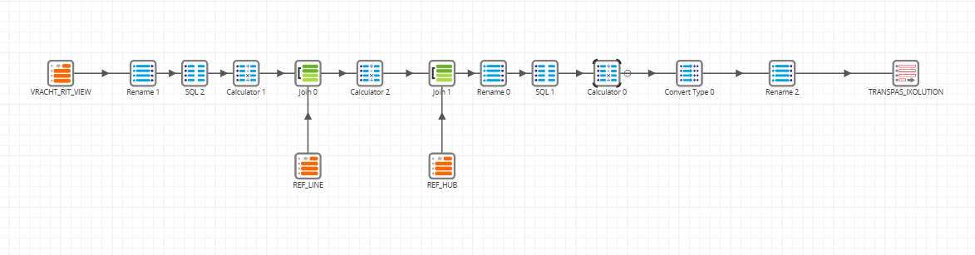
20
Week 20 - Evidencing
5/6
Example of the Data Mapping view in Matillion

Slide 56
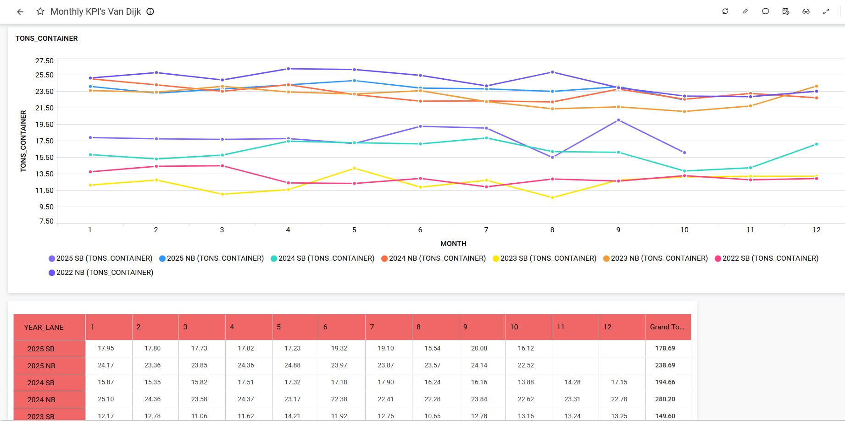
20
Week 20 - Evidencing
6/6
Example of Reporting view in Bold BI – Tons per Container

Slide 57
You made it!
You made it to the end of your placement period, congratulations! Hopefully, you have learned a lot and you gained experience with the work field, working with other professionals and became more independent in your work. As a reminder, do not forget about the following deliverables:
Remind your company supervisor about the 20th week assessment. They should fill in the assessment sheet provided and discuss their outcomes with you. Reflect on their feedback and see how you improved yourself compared to the 10th week feedback. Afterwards, your supervisor needs to send the signed version to your BUas supervisor!
Plan a meeting with your company supervisor, your Buas supervisor and you to discuss the end of your placement.
Do not forget to update your learning log! Make sure that the log is accessible for your Buas supervisor so they can have a look at what you have done.
Finalize all the deliverables and hand them in on time!
Make sure to thank your supervisor at the company and other team members! Update your LinkedIn and maybe add your colleagues to further build your network.

Slide 58
Section C
C
Progress
Intended Learning Outcomes
Notes:
MUST BE COMPLETED IN WEEK 20, BUT SHOULD BE UPDATED REGULARLY
This is where you link your evidence to each of the Intended Learning Outcomes of this block.

Slide 59
Component A
A
Research

Slide 60
A
Research
10 points total
1/3
1
Company and Role Context
The student provides a clear, concise, and insightful overview of the company, its structure, market, and work culture. The role of the student within the organization is described accurately and connected to the relevance of the project.
In Section 1 and Section 2, I clearly introduce the context of the work placement, my role as a Data Integration and BI Automation Intern, and the objective of the project. I explain how my responsibilities directly supported the need for automated reporting following the acquisition of Van Dijk Logistics, linking my role to the relevance of the project. In Section 3, I provide a concise overview of Move Intermodal, including its market position, services, and organizational structure. The company context is connected to the business challenge that the project addresses. The organizational placement of my role is further clarified through Figure 1, which shows how I was positioned within the IT department and how I collaborated with different stakeholders. Together, these sections demonstrate a clear understanding of the company context and my role within it.
This is demonstrated in: Section 1 and Section 2 – Introduction and Project Description (pages 2–5) of Portfolio - Work Placement Portfolio Section 3 – Company Description (pages 5–7) of Portfolio - Work Placement Portfolio Figure 1 – Organizational Chart (IT Department) (page 6) of Portfolio - Work Placement Portfolio Company evaluation form - Company Evaluation Form Week 20

Slide 61
A
Research
10 points total
2/3
2
Ethical and Legal Considerations
The student provides a nuanced and critical analysis of ethical and legal aspects relevant to the work, applying recognised frameworks (e.g., GDPR, AI ethics) and reflecting on their own role in decision-making.
In Section 8, I analyse the ethical and legal aspects of working with operational logistics data, applying GDPR principles such as data minimisation, purpose limitation, and controlled access. I explain how potentially sensitive or indirectly identifiable data was handled carefully and only used when necessary for the reporting objectives. In Section 5, I demonstrate ethical decision-making through selective use of data, where only relevant tables and attributes were included in the data model and reporting layers. This shows the practical application of legal and ethical frameworks in data engineering decisions. In Section 6, I reflect on my responsibility for data correctness and transparency by describing how inconsistencies, duplicates, and unclear mappings were investigated and resolved. I also highlight my role in discussing ethical and legal uncertainties with supervisors and stakeholders before making final decisions.
This is demonstrated in: Section 8– Ethical and Legal Considerations (page 14) of Portfolio - Work Placement Portfolio Section 5 – Data Description (page 8) of Portfolio - Work Placement Portfolio Section 6 – Methodology and Implementation (pages 8–13) of Portfolio - Work Placement Portfolio Company evaluation form - Company Evaluation Form Week 20

Slide 62
A
Research
10 points total
3/3
3
Integration of Research and Theory
The student integrates relevant literature, frameworks, and best practices, making clear and well-argued connections between theory and practice.
In Section 4 (Theoretical Background and Literature Study), I introduce and explain relevant frameworks and best practices that guided the project, including Data Vault 2.0, CRISP-DM, and modern data warehousing principles. These theories provide the foundation for how data integration, modeling, and reporting were approached. In Section 6 (Methodology), I explicitly connect these theoretical concepts to practice by explaining how Data Vault principles were applied in Matillion and Snowflake through the creation of hubs, links, satellites, and incremental loading logic. The CRISP-DM framework is reflected in the structured way the project progressed from understanding business requirements to data preparation, modelling, validation, and reporting. In Section 7 and Section 9 (Evaluation & Discussion), I reflect on the effectiveness and limitations of applying these frameworks in a real business environment. I discuss trade-offs between theoretical best practices and practical constraints such as data quality issues, legacy systems, and reporting deadlines. This demonstrates critical reflection rather than a purely descriptive use of theory.
This is demonstrated in: Section 4 – Theoretical Background and Literature study (pages 7–8) in Portfolio - Work Placement Portfolio Section 6 – Methodology (pages 8-13) in Portfolio - Work Placement Portfolio Section 7 & Section 9 – Evaluation & Discussion (pages 13-14 and page 15) in Portfolio - Work Placement Portfolio Company evaluation form - Company Evaluation Form Week 20

Slide 63
Component B
B
Product

Slide 64
B
Research
15 points total
1/3
4
Understanding and Approach
The student demonstrates a deep understanding of the project’s goals and challenges, including relevant context and constraints. They articulate a well-justified approach that aligns with the chosen role (e.g., requirement analysis, data handling, modelling, engineering, or other relevant outputs).
In Section 2 (Project Description and Timeline/Plan), I demonstrate a clear understanding of the project goals and constraints by explaining the business problem caused by manual reporting after the acquisition of Van Dijk Logistics, as well as the technical and organisational challenges involved in automating reporting within an existing data platform. I also explain the original project scope and how it evolved during the placement. In Section 2.3 and 2.4, I explicitly describe the challenges encountered during the report rebuilding phase, such as limited stakeholder availability and undocumented business logic. I justify the decision to adjust the approach by prioritising data mapping before report rebuilding, showing a well-reasoned and adaptive project strategy aligned with real-world constraints. In Section 6 (Methodology and Implementation), I clearly articulate the chosen technical approach, including the use of Data Vault 2.0, Snowflake, Matillion, and Bold BI. I explain why specific modelling levels (Dossier, Rit, Vracht) were chosen and how the Vracht level was identified as the most suitable grain for analysis. This demonstrates a deep understanding of both the data and the business processes. In Sections 7 (Evaluation and Testing) and 9 (Discussion), I reflect on how the chosen approach performed in practice, including its strengths and limitations. I show awareness of trade-offs between technical best practices and business realities, such as data quality issues, legacy reporting logic, and stakeholder expectations.
This is demonstrated in: Section 2 – Project Description and Timeline/Plan (pages 2–5 in Portfolio) - Work Placement Portfolio Section 6 – Methodology and Implementation (pages 8–13 in Portfolio) - Work Placement Portfolio Section 7 – Evaluation and Testing (pages 13–14 in Portfolio) - Work Placement Portfolio Section 9 – Discussion (page 15 in Portfolio) - Work Placement Portfolio Weekly work and learning logs - Work Log Company evaluation form - Company Evaluation Form Week 20

Slide 65
B
Research
15 points total
2/3
5
Execution and Methods
The student carries out the work to a high professional standard using appropriate, well-chosen, and transparent methods and tools. The approach is adapted where necessary to suit the project’s context, with clear documentation of the process.
In Section 6 (Methodology and Implementation), I demonstrate professional execution by clearly describing the tools and methods used throughout the project, including Matillion for ETL orchestration, Snowflake as the data warehouse, and Bold BI for reporting. I explain how these tools were selected to fit the existing Move Intermodal data platform and business requirements. I document the implementation of Data Vault 2.0 modelling in a structured and transparent way, detailing the creation of hubs, links, satellites, link satellites, and incremental loading logic using LOAD_DATE and LOAD_END_DATE. This shows a consistent and methodical execution aligned with industry best practices. In Section 7 (Evaluation and Testing), I describe how the results were validated through data checks, comparisons with legacy reports, and iterative testing with stakeholders. When discrepancies were found, I adapted the approach by refining mappings, adjusting joins, and revisiting assumptions, demonstrating flexibility and problem-solving in execution. Throughout Sections 6, 7, and 8, I provide clear documentation of decisions, challenges, and changes made during implementation, ensuring that the process is transparent and reproducible.
This is demonstrated in: Section 6 – Methodology and Implementation (pages 8–13 in Portfolio) - Work Placement Portfolio Section 7 – Evaluation and Testing (pages 13–14 in Portfolio) - Work Placement Portfolio Section 8 – Ethical and Legal Considerations (page 14 in Portfolio) - Work Placement Portfolio Weekly work logs and learning logs - Work Log Company evaluation form - Company Evaluation Form Week 20

Slide 66
B
Research
10 points total
3/3
5
Understanding and Approach
The student delivers robust and relevant outcomes that address the project goals and add value to the organization. Limitations are identified and addressed, and results are evaluated for effectiveness in the organizational context.
In Section 6 (Methodology and Implementation), I describe how the project was executed using professional, well-documented methods and tools. I explain how Data Vault views, Data Marts, and BI dashboards were implemented to replace manual reporting with an automated solution. In Section 7 (Evaluation and Testing), I evaluate the delivered outputs against the original project goals by validating automated reports against existing manual reports. I describe how discrepancies were identified, analysed, and resolved, demonstrating that the results were tested for correctness, consistency, and usability in a real organisational context. In Section 9 (Discussion), I reflect on the value delivered to the organisation, as well as the limitations encountered, such as data quality issues and limited stakeholder availability. I explain how these constraints influenced the final outcomes and how they were addressed through technical adjustments and stakeholder alignment. In Section 10 (Conclusion), I summarise the overall impact of the project, highlighting how the implemented solution provides a scalable, reliable, and automated reporting foundation that adds long-term value to Move Intermodal.
This is demonstrated in: Section 6 – Methodology and Implementation (pages 8–13) in Portfolio - Work Placement Portfolio Section 7 – Evaluation and Testing (pages 13–14) in Portfolio - Work Placement Portfolio Section 9 – Discussion (pages 15) in Portfolio - Work Placement Portfolio Section 10 – Conclusion (page 15-16) in Portfolio - Work Placement Portfolio Company evaluation form - Company Evaluation Form Week 20

Slide 67
Component C
C
Professional and Personal Development

Slide 68
C
Professional and Personal Development
10 points total
1/3
7
Professionalism and Structure
The student presents a portfolio that is well-structured, logically organized, and professionally formatted. Language, tone, and visual presentation meet professional industry standards. The student presents results using accurate and clear visualizations, tailored to the intended audience. Referencing and writing follows APA7 or other standardized guidelines consistently.
The portfolio is structured in a clear, logical, and academic format, following a consistent flow from introduction and company context to methodology, evaluation, discussion, and conclusion. Each section builds on the previous one, making the document easy to follow for both academic assessors and business stakeholders. Throughout the portfolio, I use professional language and tone, avoiding informal wording and ensuring clarity and precision in technical explanations. The writing style is consistent across sections and tailored to a data and business-oriented audience. Visual elements are used where relevant to support the explanations, improving readability and comprehension. All references to academic literature and frameworks are consistently formatted using APA7, and in-text citations are aligned with the reference list, demonstrating attention to academic standards and detail.
This is demonstrated in: Overall Portfolio structure (pages 1–17) - Work Placement Portfolio Section 4 – Theoretical Background and Literature Study (pages 7–8) in Portfolio - Work Placement Portfolio Section 6 – Methodology and Implementation (pages 8–13) - Work Placement Portfolio Reference list (final page): consistent APA7 formatting - Work Placement Portfolio Company evaluation form - Company Evaluation Form Week 20 Come-back day Presentation - Presentation

Slide 69
C
Professional and Personal Development
10 points total
2/3
8
Reflection on Personal Development
The student provides an honest and in-depth reflection on their set learning goals, learning process, skill development, and challenges faced during the placement. Concrete and realistic future learning goals are identified based on these reflections.
In the Reflection section, I provide an honest and critical reflection on my learning process during the internship, describing how my understanding evolved from initial on boarding to independently designing data models, mappings, and reporting solutions. I explicitly reflect on the skills I developed, including technical skills as well as professional skills such as problem-solving, stakeholder communication, and working with incomplete or inconsistent data. Challenges faced during the placement, such as data quality issues, unclear source systems, and tight reporting deadlines, are clearly described together with the actions I took to overcome them and the lessons learned. Based on these reflections, I define concrete and realistic future learning goals, such as deepening my data engineering knowledge, improving documentation and validation practices, and further developing my ability to translate business questions into data solutions.
This is demonstrated in: Section 11 - Reflection and learning experience (page 16) in Portfolio - Work Placement Portfolio Evaluation & Discussion sections (pages 13–15): reflection on challenges, limitations, and learning outcomes - Work Placement Portfolio Work and Learning logs - Work Log Company evaluation form - Company Evaluation Form Week 20 Come-back day Presentation - Presentation

Slide 70
C
Professional and Personal Development
10 points total
3/3
9
Engagement with Company Feedback
The student received a mid-way and final performance review from the company supervisor. The student documents mid-placement and final reviews, providing concrete responses that demonstrate adaptation of work based on feedback received.
I actively engaged with mid-term feedback (Week 10) and final feedback (Week 20) from my company supervisors and used it to adjust my way of working, communication, and planning during the second half of the internship. During the mid-term evaluation, feedback indicated strong technical progress but highlighted the need for more proactive communication and follow-up, especially when working with stakeholders who were difficult to reach due to organizational changes and remote collaboration. Based on this feedback, I improved escalation and follow-up, scheduled clearer alignment meetings, and documented dependencies and open questions more explicitly. This is reflected in later weeks where communication with both the internal Move team and the Van Dijk stakeholders improved. The final evaluation (Week 20) explicitly confirms this improvement: communication and escalation were present and improved in the second half of the internship, adaptability was rated positively, and independence on the technical side was rated as excellent. I demonstrate reflection on feedback by acknowledging limitations caused by external dependencies, while also showing how I adapted my behaviour and planning to mitigate these constraints and still deliver a valuable end result.
This is demonstrated in: Company Evaluation Form – Week 10 - Company Evaluation Form Week 10 Company Evaluation Form – Week 20 - Company Evaluation Form Week 20 Section 9 (Discussion) and Section 11 (Reflection) in Portfolio (pages 13-15) - Work Placement Portfolio Work and Learning Logs - Work Log Learning Log Week 10 feedback and Week 20 feedback Come-back day Presentation - Presentation

Slide 71
Section D
D
Reflection
Notes:
MUST BE COMPLETED IN WEEK 8
Summative reflection on your progress during the block including a critical assessment of everything you did and learned during the block. This is a comprehensive review of everything recorded in Section B, evaluated against the goals and planning laid out in Section A.

Slide 72
D
What did I achieve this block?
1/2
My most significant achievements during my placement
During my placement, I successfully designed and implemented multiple data marts in Matillion, integrated them with Snowflake, and connected them to Bold BI for reporting. I applied Data Vault 2.0 principles in a real business environment and delivered automated, validated reports used by the company. I also completed a full professional portfolio documenting the project, methodology, and outcomes.
My most difficult challenges my placement
The most difficult challenge during my placement was that I was working between two companies and people from both of them which led to a situation where I could not continue my work due to the limited available of the people in the Van Dijk office. Communication with them was tough, but happily at the end we managed to schedule all meetings I needed and completed the project on time.
The most important lessons I learned during my placement
The most important lessons I learned during my placement were the importance of clear communication, stakeholder alignment, and flexibility in a real business environment. I learned that technical work often depends on timely input from others, and progress requires proactive planning and follow-ups. Additionally, I learned how to adapt theoretical knowledge to practical constraints while still delivering valuable and reliable results.

Slide 73
D
What did I achieve this block?
1/2
These where the qualities I intended to work on indicated in section A
I intended to further develop my practical data engineering skills, especially in working with complex data models and reporting tools in a real business environment. In addition, I aimed to improve my communication with non-technical stakeholders, gain confidence in translating business requirements into technical solutions, and learn how to work effectively across multiple teams and organizations.
This is how I feel like I improved on those qualities
During the placement, I significantly strengthened my data engineering skills by working with complex data models, SQL transformations, and reporting pipelines. I became more confident in structuring data solutions based on business needs and improved my ability to communicate progress, issues, and decisions with both technical and non-technical stakeholders. Working across two companies helped me adapt to different expectations and collaboration styles.
This is the advice I would give myself if I would start my placement with the knowledge I have now
I would advise myself to clarify dependencies and stakeholder availability earlier, ask questions sooner, and proactively align expectations between all parties involved. This would help reduce delays and make collaboration smoother, especially when working across multiple organizations.

